Slide 1
Creative & Content Communication Work
November 15 – December 14

Slide 2
Graphics
Creative

Slide 3
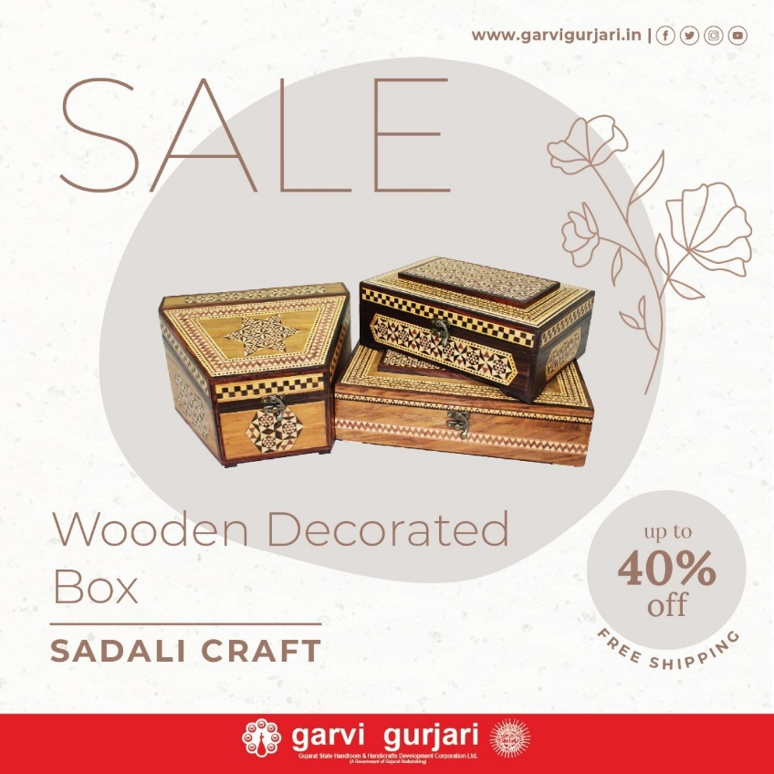

Slide 8
Christmas
Creative

Slide 12
Articles on the subject of rich Handicrafts &
Handloom Heritage of Gujarat

Slide 13
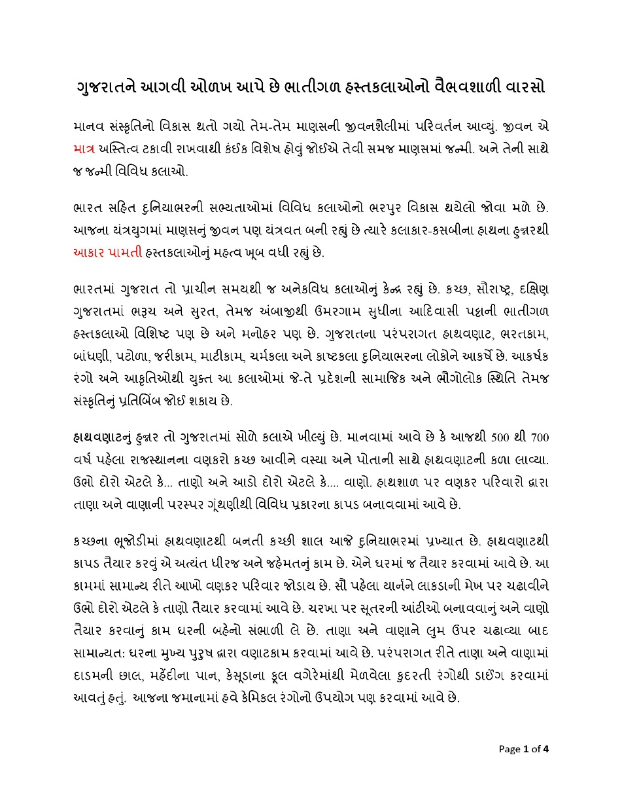
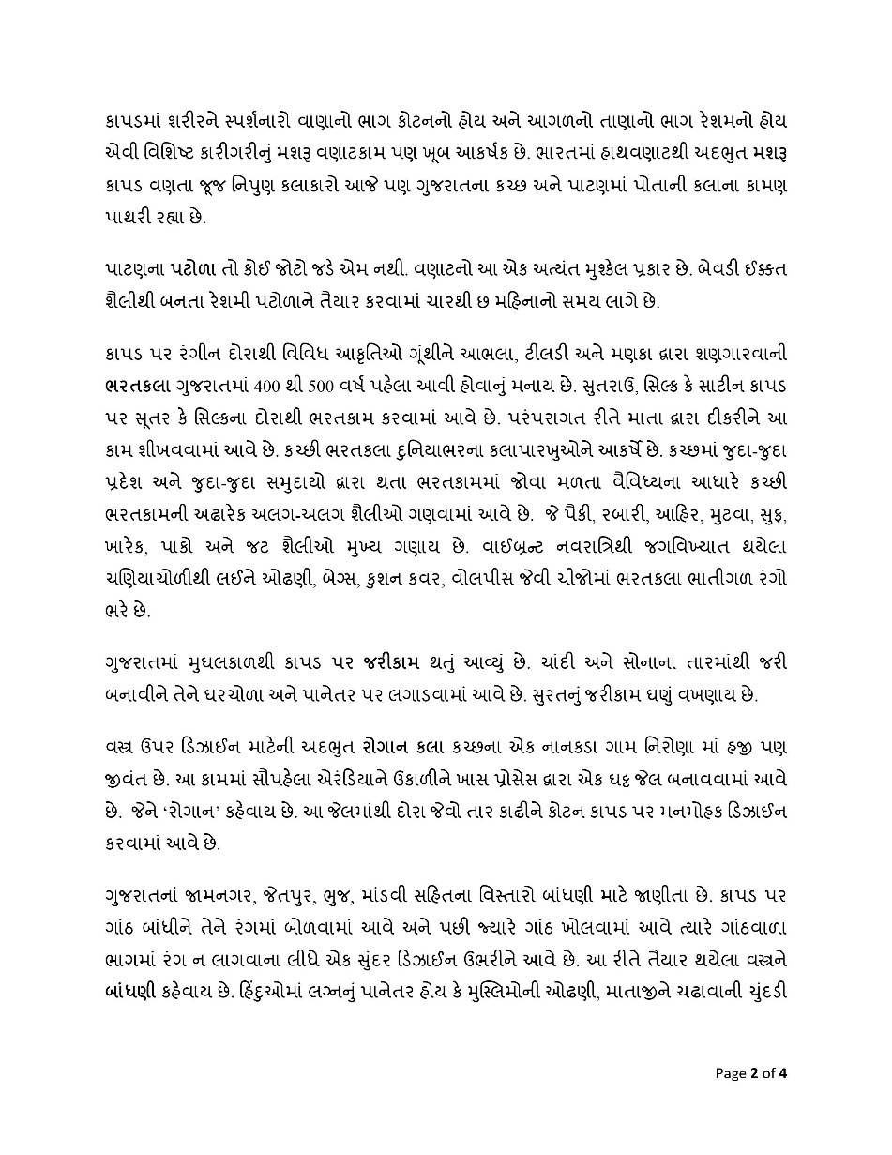

Slide 14
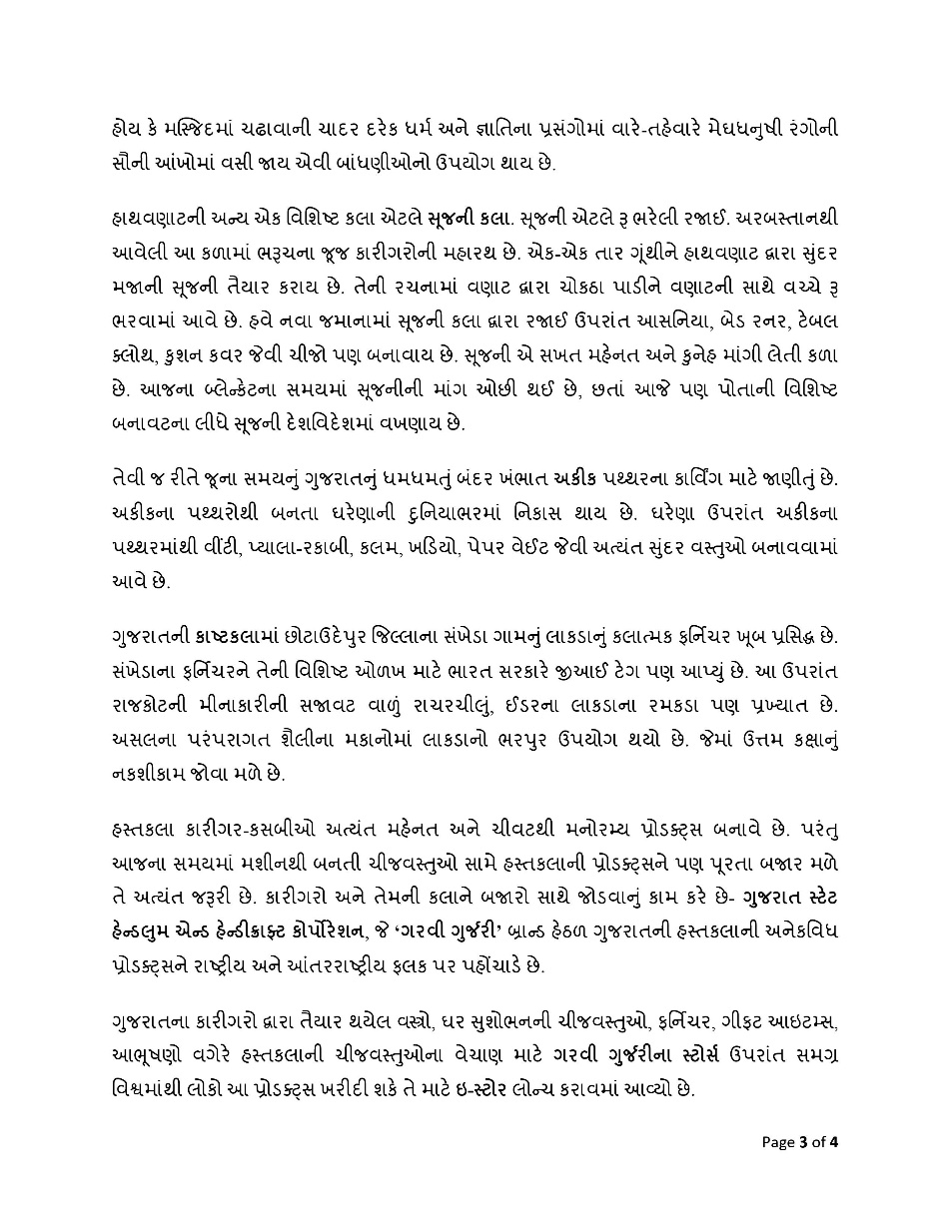
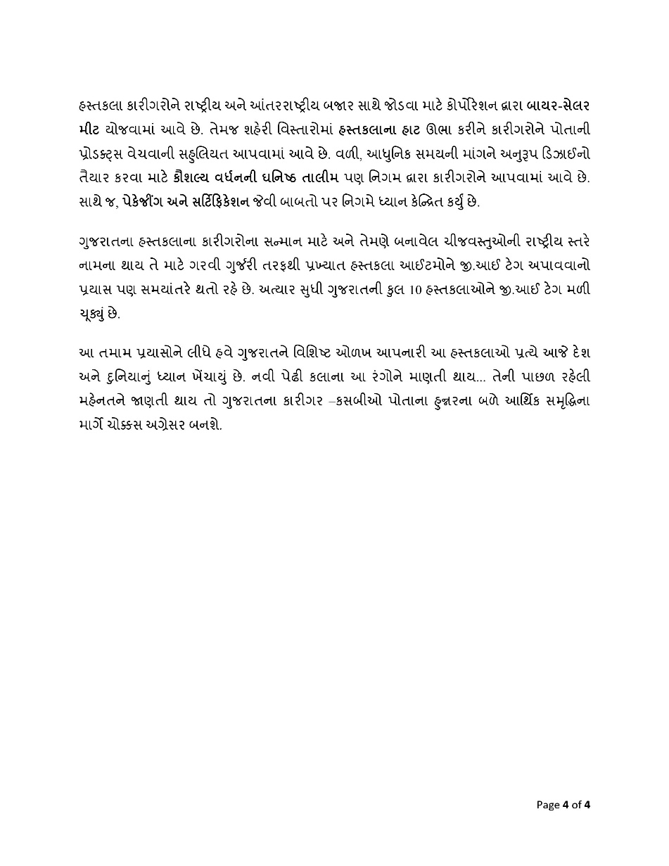

Slide 15
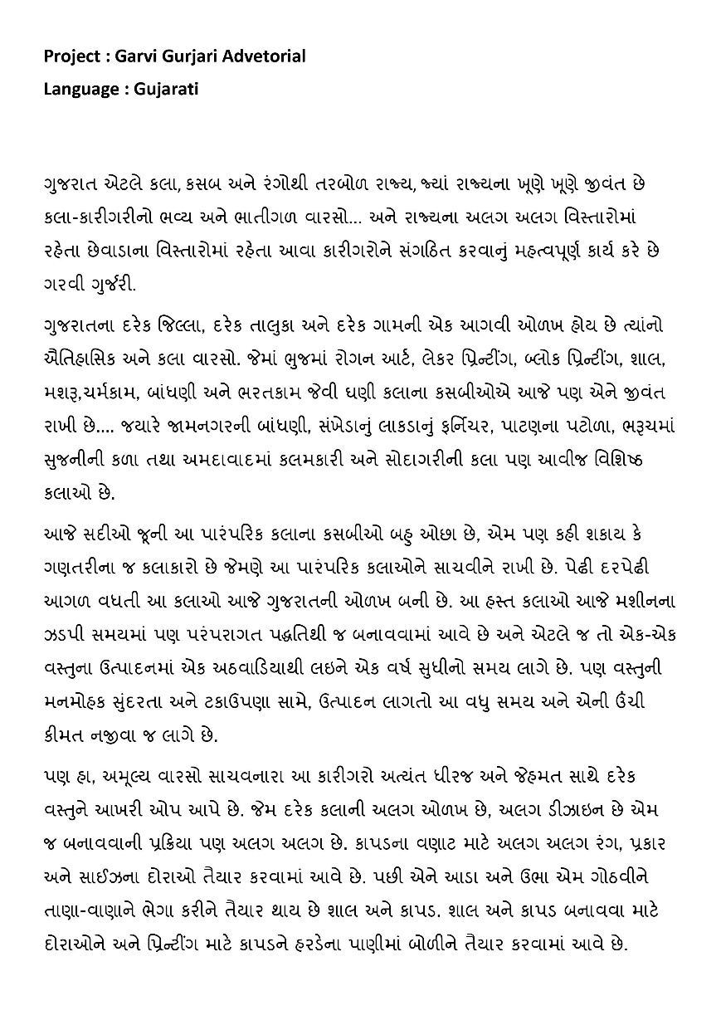
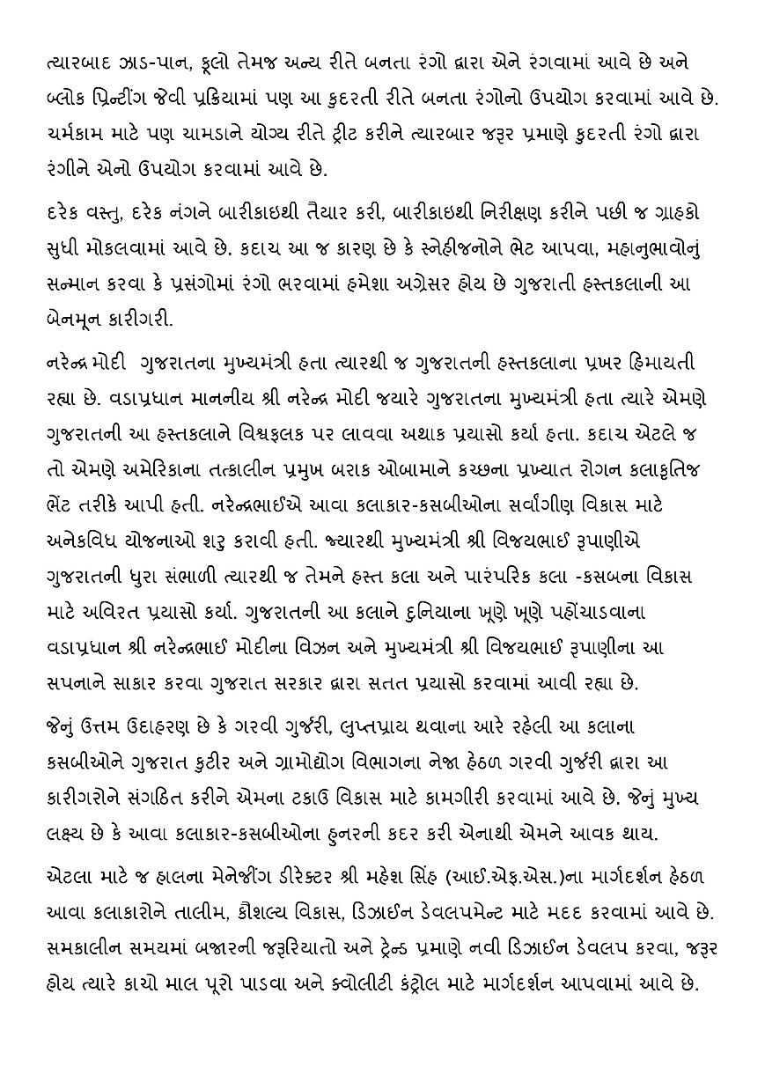

Slide 16
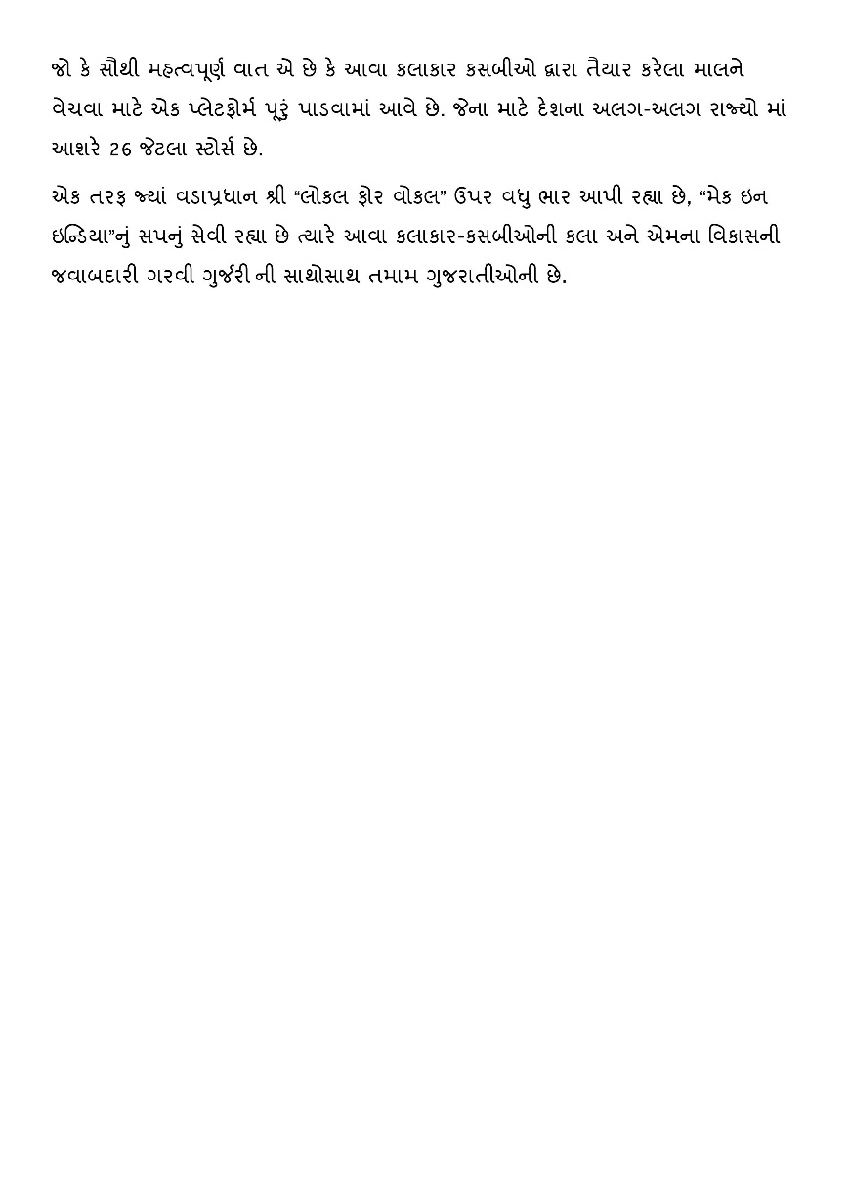

Slide 17
Thank You

