Slide 1
SOCIAL MEDIA WORK
January 15 to February 15
by

Slide 5
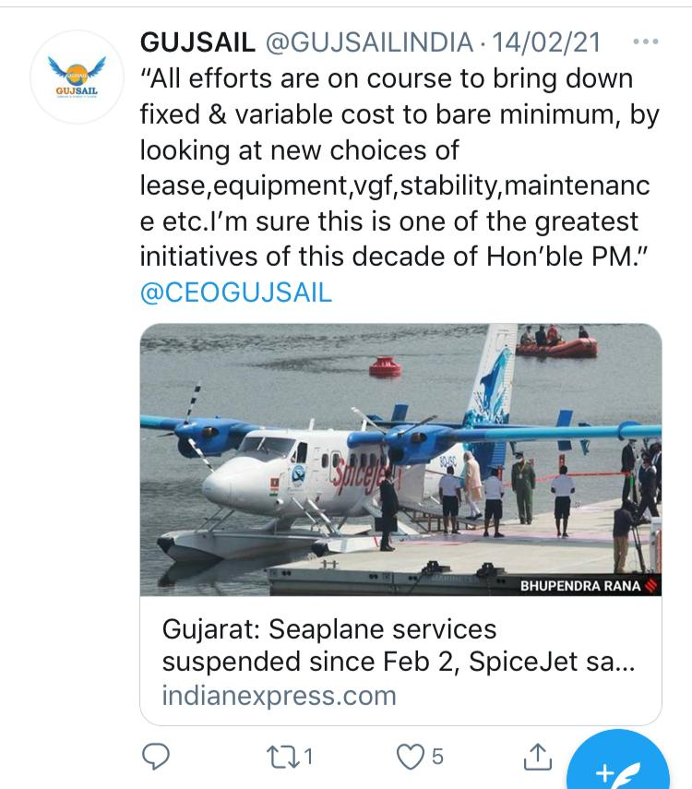
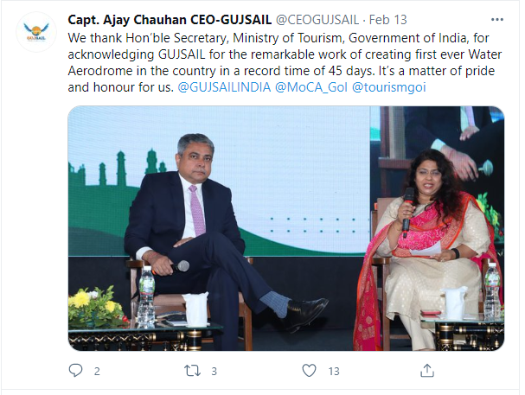

Slide 8
Important Days For Posting

Slide 10
Thank You

